Slide 1
Unlocking Revenue Potential
Data-Driven Ticket Pricing Strategy for Big Mountain Resort

Slide 2
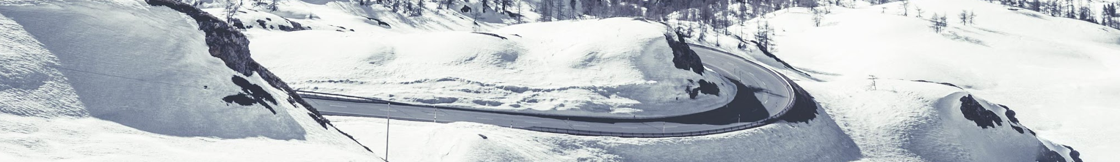
Big Mountain Resort Overview:
Location: Montana, offering stunning views of Glacier National Park and Flathead National Forest
Facilities: 105 trails, 11 lifts, 2 T-bars, 1 magic carpet
Visitor Stats: 350,000 annual skiers/snowboarders
Longest Run: Hellfire (3.3 miles)
Elevation: Base-4,464ft, Summit-6,817ft, Vertical Drop- 2,353ft
Recent Addition: New chair lift, increasing operating costs by $1,540,000
Pricing Strategy: Premium above market average, seeking data-driven approach
Goal: Optimize ticket pricing, explore cost-cutting options, and support higher prices

Slide 3
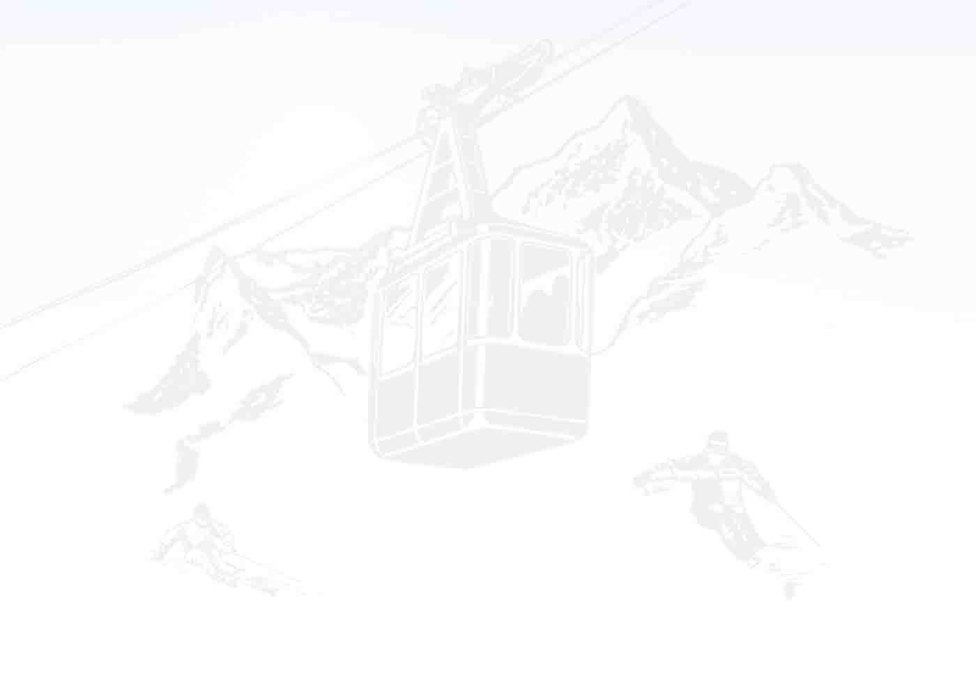
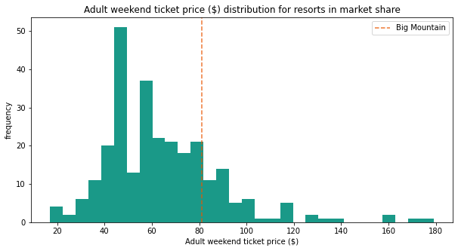
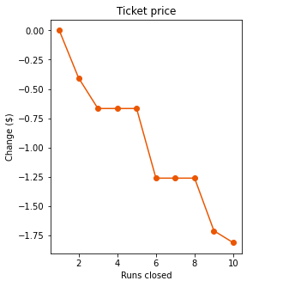
Recommendation and Key Findings
Increase Ticket Price to $95.83 By implementing this pricing adjustment, the resort can better align its rates with the value it offers to customers, ultimately maximizing revenue potential
Close One Run The operating costs can potentially reduced by closing one run without impacting the ticket price. However, closing 2 or 3 runs would have an impact on the ticket price. Interestingly, closing 4 or 5 runs would not lead to a further decrease in the ticket price

Slide 4
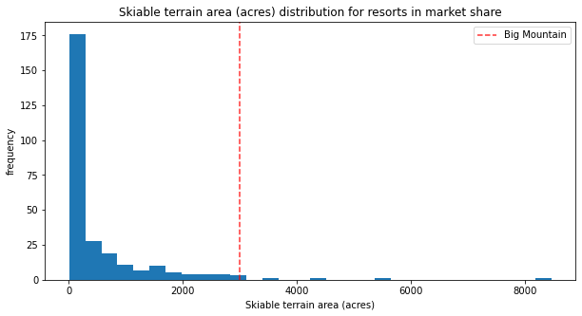
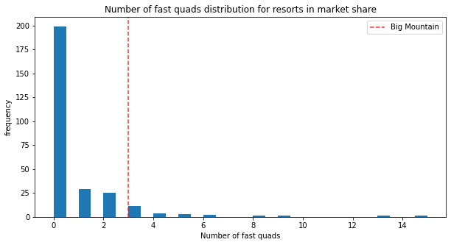
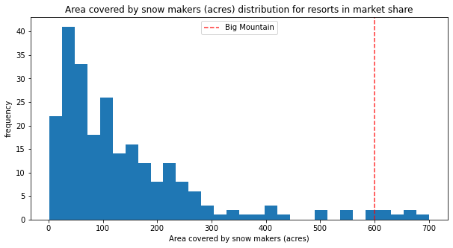
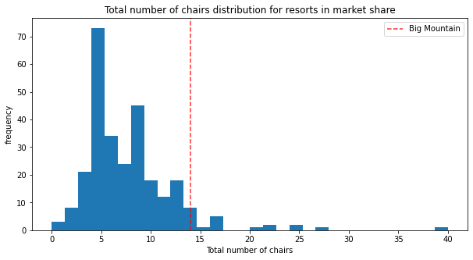
Big Mountain ranks among the top resorts when it comes to snowmaking coverage, chair quantity, fast quad availability, run count, and skiable terrain area

Slide 5
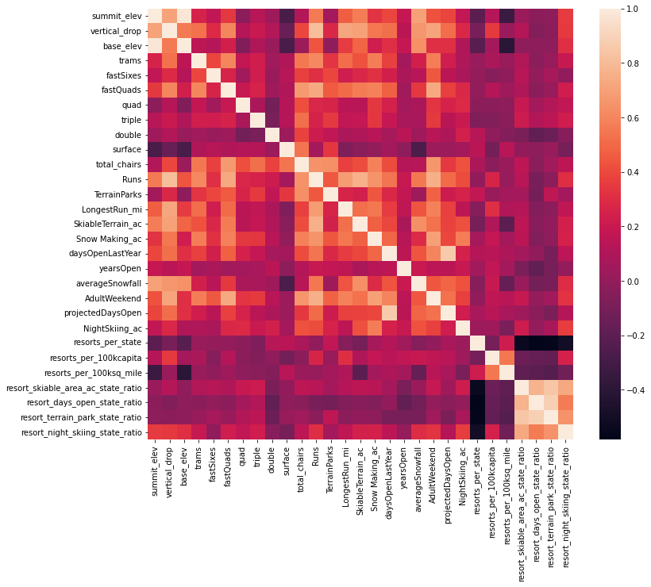
Modeling Results and Analysis
The “AdultWeekend” column is identified and used as the target variable. “AdultWeekday” is removed from the dataset because of excessive vissing values. A correlation Heatmap suggests some interesting findings:
Summit and base elevation are quite highly correlated.
Night skiing area is correlated with the number of resorts per capita
average snowfall correlated with summit elevation, vertical drop, and base elevation
the price column has a strong positive correlation with vertical drop, fastQuads, runs and Snow making_ac

Slide 6
Modeling Results and Analysis
The 226 resorts are split 70% for training purposes and 30% for testing The mean of the numerical features is used as a baseline to evaluate the performance of the trained model. A Linear Regression model resulted with a cross validation score of 0.63 and identified the 8 most significant features:
vertical_drop 10.767857
Snow Making_ac 6.290074
total_chairs 5.794156
fast Quads 5.745626
Runs 5.370555
LongestRun_mi 0.181814
trams -4.142024
SkiableTerrain_ac -5.249780
This coefficients are consistent with the results of the Heatmap. Vertical Drop having the most impact, followed by area covered by Snow Making Machines, total chairs and so on. Skiable terrain seems a bit odd, visitors tend to pay less as the skiable area of the resort increases

Slide 7
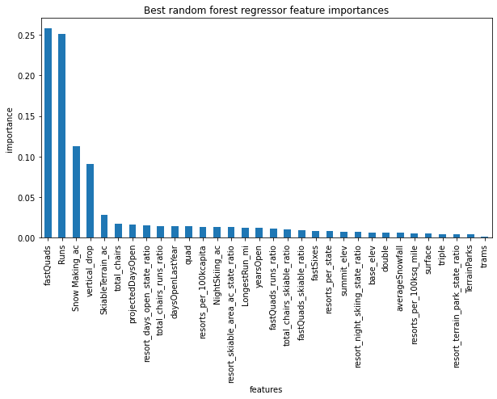
Modeling Results and Analysis
Another model is trained and tested using Random Forest Regressor.
Differently from Linear Regressor the four most important features for this model are:
Fast Quads
Runs
Snow Making_ac
vertical_drop
Linear regression cross validation performance was at 63% and Mean Absolute Error of 11.79
Random Forest scored 70% and a Mean Absolute Error of 9.53

Slide 8
Modeling Results and Analysis
The model trained on Random Forest Regressor is refitted with all available data
Ticket price predicted by the moel for Big Mountain Resort is $95.87
Mean Absolute error: $10.39
Closing one Run does not affect the ticket price, closing 3,4 or 5 runs will have the same effect
Adding a run, installing new lift and increasing the vertical drop will support price raise
Increasing longest run length or snow machine covered area doesn’t seem to have any significant change

Slide 9
Summary and conclusion
The reliability of the model's predictions is based on the underlying assumption that other resorts primarily determine their prices based on the perceived value of specific facilities.
The Big Mountain Resort tickets are underpriced
Closing one or few runs, will help reduce costs and subsequently raise the revenue
Considering the operational costs, investing in new chairlifts, new runs, and increasing the vertical drop has the potential to be profitable and should be taken into consideration

